Slide 1
Noether Cores

Slide 2
Binary Capture
Let’s say a binary axis can not be transited by the orbital of a captured binary.
At high energy, binaries can capture each other, i.e., each of their orbital axis pierce the orbit of the other.
When di-binaries form, there may be certain environments where they are semi stable assemblies.
Tri binary assemblies are very stable. They are the nucleus of all standard model particles including spacetime.
When outer binaries decay, the resulting di-binary and binary assemblies are not stable and are highly reactive.
+
+
+
−
−
−

Slide 3
Noether Core Generations
Structure Architecture
6 : Total immutable point potentials
3 : electrinos at -e/6
3 : positrinos at +e/6
0 : Personality point potentials
1 : Generation I Noether energy core
Provides 3 dimensions of stability/containment
Implements SU(3) and the strong force
Spin determines chirality of the structure
3 : orbiting electrino : positrino binaries
binaries coupled at different energy scales
binaries tend to orthogonal at v << c.
Structure become increasingly oblate with velocity.
Gen II and Gen III binary energy shielding
Transacts energy in h-bar units
Conserves angular momentum in 3D
Auto synchronizes binary energy (Koide?)
Implements stretchy ruler, variable clock
Is an ideal black body
An essential emergent building block for the universe.
Generation I Fermion Core
Generation II Fermion Core
Generation III Fermion Core
+
I
II
II
III
+
III
+
III
−
−
−
+
+
+
−
−
−
Binary | I | II | III
Energy | E_{I} << E_{II} | E_{II} << E_{III} | E_{III}
Frequency | f_{I} << f_{II} | f_{II} << f_{III} | f_{III}
Radius | r_{I} >> r_{II} | r_{II} >> r_{III} | r_{III}
KE | _{L} | _{M} | _{H}
PE | _{H} | _{M} | _{L}
2D representations of coupled binaries at different energy scales.

Slide 4
Tri Binaries Scale and are “Cloaked”
(Superposition, Frequency, Emission = q/v)
scaling by orders of magnitude

Slide 5
The Noether Energy Core
Structure Architecture
6 : Total immutable point potentials
3 : electrinos at -e/6
3 : positrinos at +e/6
0 : Personality point potentials
1 : Generation I Noether energy core
Provides 3 dimensions of stability/containment
Implements SU(3) and the strong force
Spin determines chirality of the structure
3 : orbiting electrino : positrino binaries
binaries coupled at different energy scales
binaries tend to orthogonal at v << c.
Structure become increasingly oblate with velocity.
Gen II and Gen III binary energy shielding
Transacts energy in h-bar units
Conserves angular momentum in 3D
Auto synchronizes binary energy (Koide?)
Implements stretchy ruler, variable clock
Is an ideal black body
An essential emergent building block for the universe.
+
+
−
+
−
−
2D representation of three coupled binaries at different energy scales.

Slide 6
Noether Core Animation : Noether Core Nested Tri-binary Gyroscopic Flywheel
+
+
−
+
−
−
J Mark Morris

Slide 7
Important “Phases” May Occur When One of the Binaries is “Phase-Locked” at v = @
+
+
Point Potential Velocity | Generation
Phase Hypothesis | I | II | III
Binary Max Curvature | ? | ? | max
Decay to binaries? | ? | ? | ?
Inside a black hole | >@ | >>@ | >>>@
Spacetime assemblies | =@ | >@ | >>@
? | <@ | >@ | >>@
Typical Gen I fermion? | <@ | =@ | >@
? | <<@ | <@ | >@
? | <<@ | <@ | =@
? | <<<@ | <<@ | <@
Generation I
Generation II
Generation III
−
+
−
−
J Mark Morris

Slide 8
Noether Core : A Nested Tri-Binary Assembly of Point Potentials
Group Velocity
Group Velocity
Group Velocity
+
+
+
−
+
−
+
−
+
−
+
−
+
−
+
−
−
−
Low velocity Noether core
3D fermion orientation with spin ½
Pauli exclusion principle
Fermi-Dirac statistics
Pro and anti orientations
Inertial mass = apparent energy
e.g., electrons, quarks
High velocity Noether core
Pro and anti orientations of angular momentum vectors
Oscillating mass caused by fluctuating superposition
e.g., neutrino
Velocity >= “c” Noether core
2D boson shape, ~0 exclusion
Spin 1
Bose-Einstein statistics
e.g., photon
J Mark Morris

Slide 9
Distinct Angular Momentum Vector Orientation
L
M
S
S
M
L
SLM
SML

Slide 10
Tri Binaries Have Four Forms
Tri Binary Forms | Left | Right
Pro
Anti
Place your virtual observer at (1,1,1) examining the angular momentum vectors of the three binaries.
Pro and anti are distinguished by the orientation of their angular momentum vectors — HML or HLM
Left or right is the orbital precession direction of the binaries.
The chart shows that tri-binaries have four geometrical variations.
Binaries scale by many orders of magnitude in energy, frequency, radius, and orbital velocity
♧
♢
♤
♡

Slide 11
Noether Core’s Triply Nested Binaries with Personality Potentials
+
+
+
−
−
−
Various scales of energy and radii.

Slide 12
Thank You
Questions?

Slide 13
Dynamics of Noether Cores
Noether Cores
Binary based assemblies transmit potential via their wave equation, i.e., the spiraling Dirac sphere streams.
The Noether core displaces spatial volume, occupying a volume of Euclidean time and space.
The 3D space contained within a Noether core is can only be breached if a decay occurs.
The volume displaced by a Noether core depends on energy and group velocity.
At velocities far below field speed, Noether cores thus remain distinct from each other, in a Fermi-Dirac state.
Higgs clusters
The Noether cores that implement Einstein’s spacetime are extremely well shielded. Gen II is Higgs.
Higgs Noether cores may be so well shielded that they transmit very little energy.
Higgs Noether cores become excited by the unshielded energy emanating from standard model assemblies.
This increased energy causes the Higgs Noether cores to deflate and/or distort. (stretchy-curvy spacetime)
As standard matter becomes denser, the permeating Higgs Noether cores deflate even more.
The gradient in Noether core energy and hence characteristics is the mechanism for gravity.
At extremes in energy standard model matter will react or decay and emerge as assemblies that are more stable at the higher, denser energies.

Slide 14
Dynamics of the Noether Core
As assembly group velocity increases towards local c (which approaches @),
The geometry of the Noether core and overall assembly becomes more oblate
Transitioning towards near planar form at v = local c?
Does this map to Bose-Einstein statistics?
The magnitude of the preceding emissions transitions sharply.
What is the shape of a compressed Dirac sphere stream?
What about the closest approach and then as it continues on its group path?
These questions all remain to be pondered and simulated.
Standard model matter presents its generation I apparent energy (mass),
When standard model assemblies decay in a collider, they reveal more energy (mass) from the inner binaries
Naked generation II and III binaries appear to be highly reactive with Higgs aether assemblies.
Is there anything that can fly through a Noether core without reacting? Through any orbital?
It would need to be extremely high velocity, perhaps greater than @, perhaps higher than the gen II or gen III binary.
My hunch is that non-shielded point potentials or assembly fragments would quickly react like we see in collider particle showers and their energy and point potentials would either become Noether cores of spacetime aether or standard model particle assemblies. It is a Monte-Carlo phase space. If that makes sense.

Slide 15
Dynamics of the Noether Core
All point potentials are constant rate emitters of potential.
Noether cores themselves present a very low energy wave equation.
High frequency, attenuated emission magnitude q/|v|
Binaries present a swirling field at each orbital pole.
Compared to Noether cores of spacetime, fermions are lower energy with larger orbital radii.
The architectural configuration for each fermion has significant apparent energy, i.e., mass.
Spacetime Noether cores are excited by the potential emitted by lower energy fermion assemblies.
The potential fields received by the point potentials in spacetime assemblies cause energy transfer
When binaries receive energy, point potential speed increases and the binary radius decreases.
Both PE and KE change in classical analysis.
Fermion assemblies are the basis for all “massy” matter.
Other standard model particles are ephemeral (Ws, Z, and exotics) or have very low mass (neutrino, photon).
A fermion has six lower energy point potentials in the poles of a triply nested binary Noether core.

Slide 16


Dynamics of the Noether Core - Ideation
A Higgs cluster has two pro and two anti Noether cores. Do they couple like a Helium nucleus?
Our photon model suggests that counter-rotating binaries strongly couple.
Let’s speculate we are coupling the two poles of the Gen III binary (highest energy binary).
There are 4 Gen III binaries in a Higgs cluster.
We have 8 poles to couple.
Pro1, Pro2, Anti1, Anti2, each with L or R angular momentum
Gen II binaries may also couple. Gen I binaries may also couple
To what degree, if any, do these Gen III axial couplings contribute to assembly shielding?
Two orbiting electrons
pro
anti
binary
Two pro and two anti Noether Cores coupled as a Higgs cluster.
Helium Nucleus
is two protons and
two neutrons
polar vortices
anti
pro
Getty

Slide 17
Noether Core Geometry and the Lorentz Factor
At high velocity, Noether cores become more oblate. Do all Noether cores, pro and anti, left and right, fold the same?
In a standard matter particle? Yes. We are considering the positive quadrant only, given translation.
Therefore, they fold either LLL or RRR. Anti-ness disappears in the boson state because it was based on spin ½.
Standard matter particles are low total energy, but high apparent energy.
In a photon? Photons are bosonic planar. Photons are a pro and anti Noether core, contra-rotating at an offset.
Approaching a black hole? At some point all that is left is
Photons which were already planar, but also biplanar.
Does the crossing of the event horizon separate the pro and anti Noether cores of a photon?
Noether cores. Getting smaller and more oblate and planar at the event horizon
Interior to the black hole
Everything is planar and photons (contra rotating pro and anti Noether core) continue to deflate. Independent Noether cores are planar and deflate.
Orbitals perturb each other, causing orbit reversals all the way down. Approaching maximum curvature we have ring out until the core locks into one relative microstate, i.e., zero relative entropy.
All have mirror symmetry.
But this is occurring in a plane so CW and CCW are important factors.
Ok so let’s enumerate them LLL LLR LRL LRR RLL RLR RRL RRR (8, essentially it is binary).
Then it is emergence again
Note, when we are talking velocity here, it is usually transverse orbital velocity. Translational velocity is considered independent at this level of analysis)

Slide 18
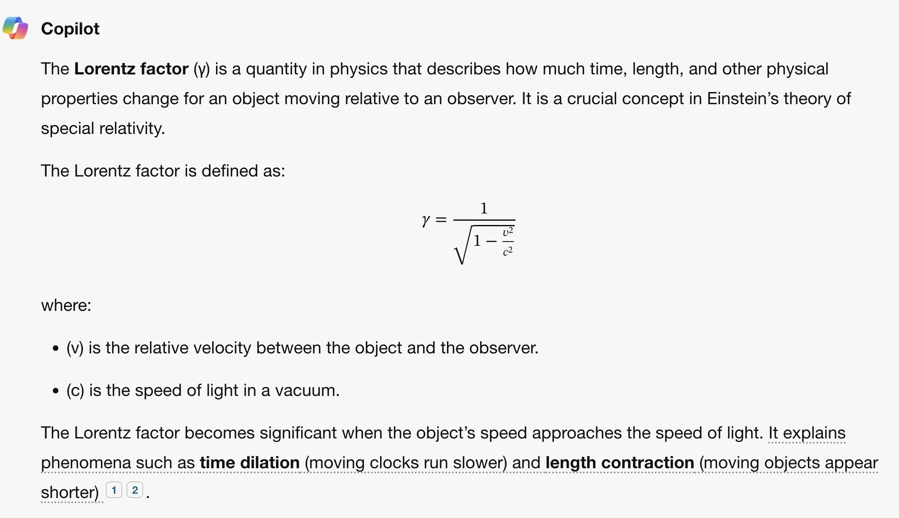
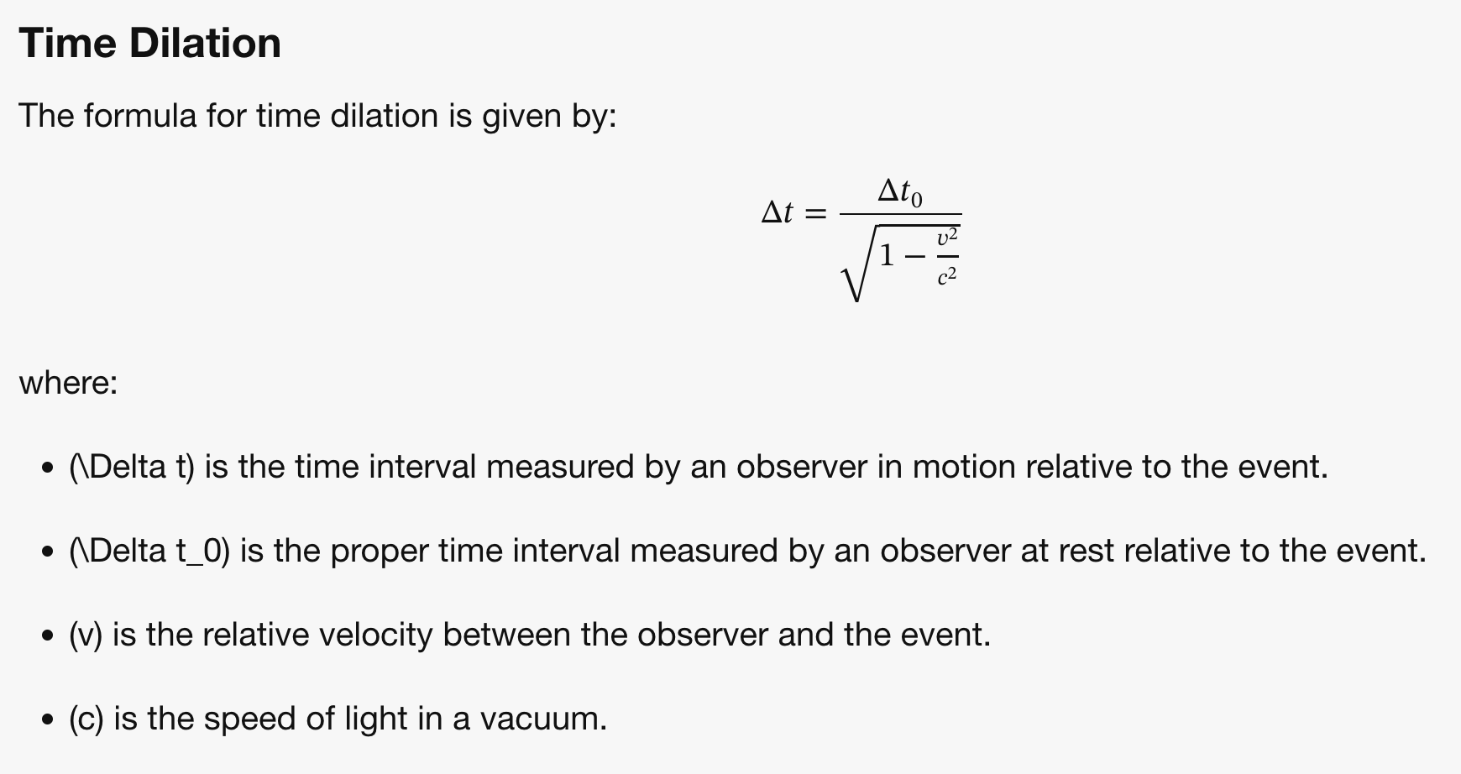
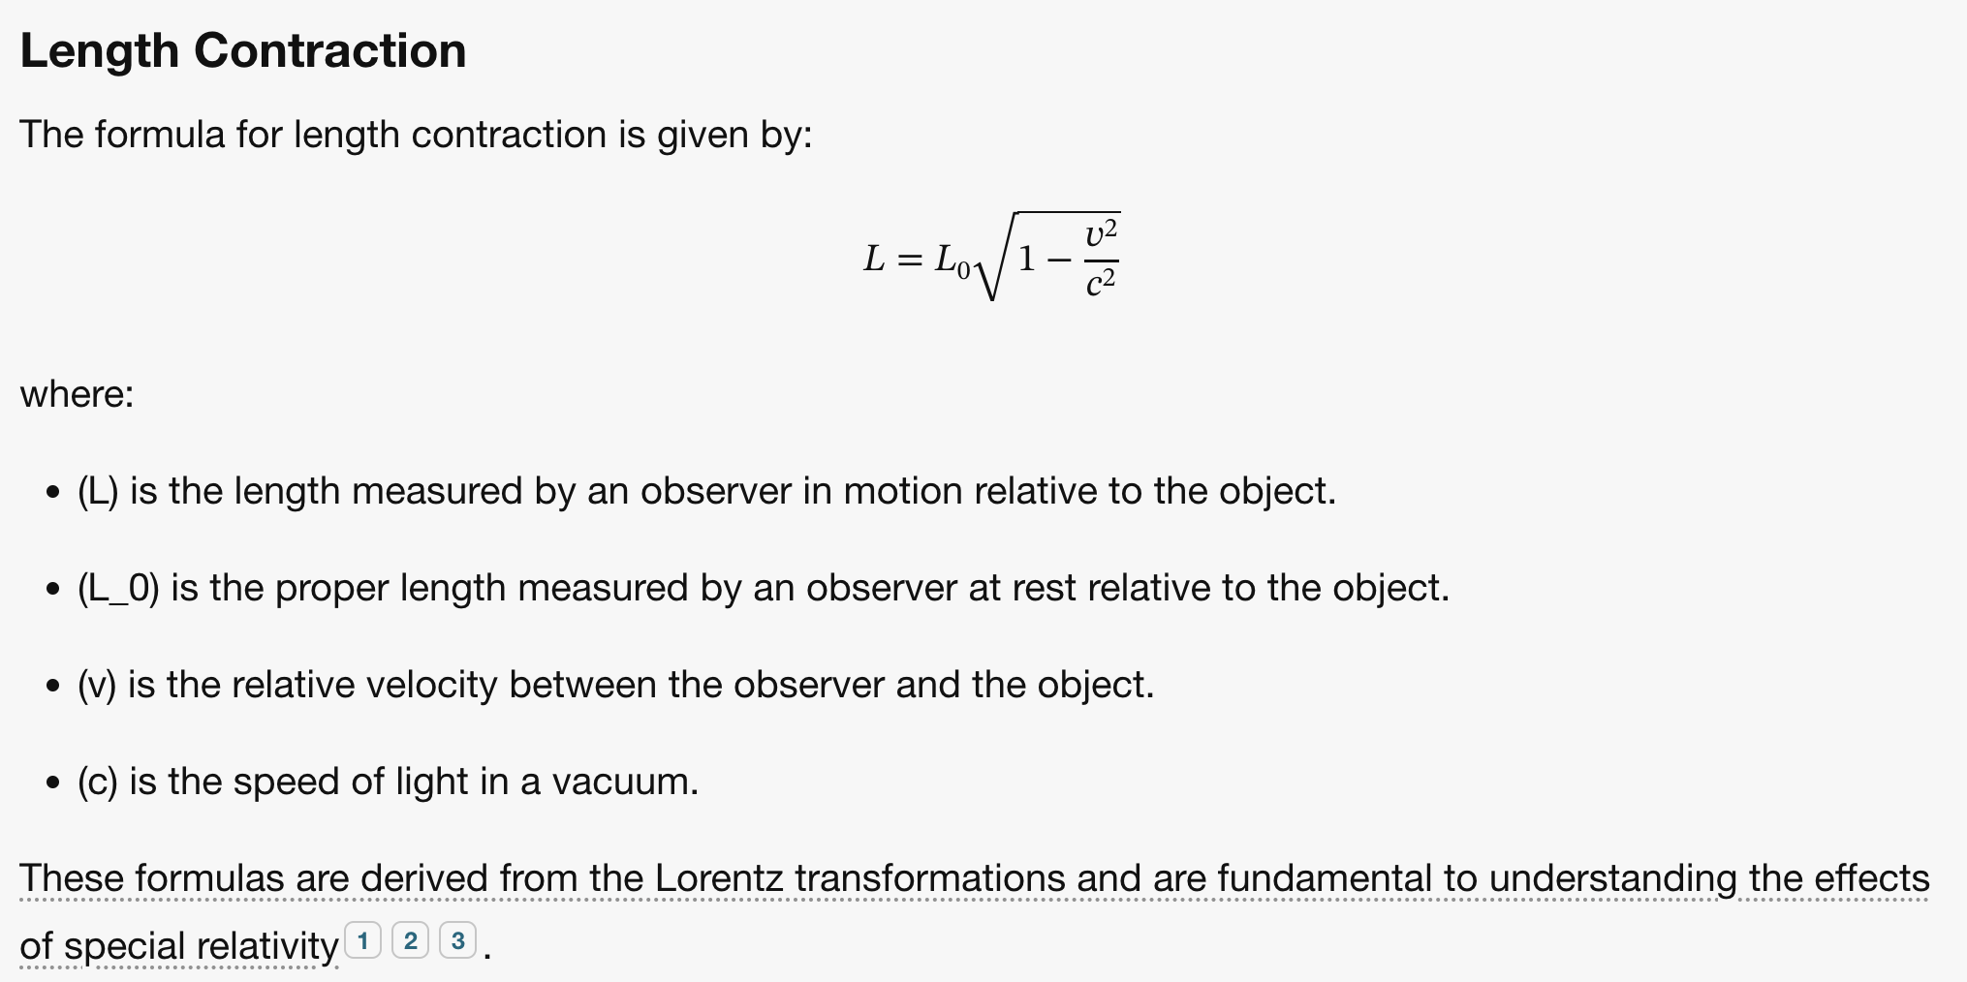
Noether Core Geometry and the Lorentz Factor
What is the Lorentz factor describing?
It may be the oblateness, turning into pancaking of the orbitals in each Noether core.
If we think of it from an action point of view, it would suggest that r is approaching zero.
We already know that v and r are related.
The symmetry breaking point occurs at v = @.
This appears to correspond to the Planck scale.
However, this is approaching the symmetry breaking point from only one side.
There is more beyond, “Plus Ultra” as the self-action begins and the deflation begins in earnest.

Slide 19
Brainstorming on Noether Core Dynamics
Binary Architecture (unperturbed)
When v <= @ the physics is only due to partner emissions
When v > @ the physics is due to both partner emissions and self emissions.
Noether Core Architecture
The three binaries have different relationships depending on energy regime of the assembly.
The relationship between generations is complex and depends on physics in each regime.
Higgs spacetime assembly clusters.
Does a Higgs Noether core’s outer binary have v >= @.
Standard model assemblies
fermions, photons, (W’s and Z are ephemeral, another topic)
Does the middle binary have v = @
The quanta h-bar is observable. Therefore, the quanta must remain in the outer binary.
Or this could all be nonsense…. better to simulate

Slide 20
Brainstorming on Noether Core Dynamics
Orbits are presumably elliptical in an assembly relative frame, with influences from translation, acceleration, gravitational gradient, precession, and self or external perturbations. Studying the ideal circular (e.g., elliptical) orbit is recommended.
It may be fruitful to examine the squashed Noether core with modeled/simulated elliptical orbits.
Is velocity constant or varying in an elliptical orbit? In classical physics velocity varies. Intuitiion : varying.
Do truly exotic stable orbits occur? Are there cases where orbitals depart substantially from planar in the short term?
In an ellipse, the lengths of the semi-major axis ((a)) and the semi-minor axis ((b)) are different.
For an ellipse with semi-major axis ( a ) and semi-minor axis ( b ), there isn’t a simple exact formula for the circumference.
The approximation from Ramanujan is often quite accurate : [ C \approx \pi \left[ 3(a + b) - \sqrt{(3a + b)(a + 3b)} \right] ]
A circle is technically a special case of an ellipse where the two axes are equal (a = b).
For a circle with radius ( r ), the circumference is given by the simple formula: C = 2 pi r
todo: check references and formulas

Slide 21
Brainstorming on Noether Core Oblation
A bare Noether core is presumably orthogonal on the cartesian planes, with orbital axis coinciding with x, y, z axes
Electron similar but perhaps more chaotic? All personality electrinos acting upon each other.
An orthogonal core would orient to pi/4 in each orbital plan in the vector direction of the group velocity.
In other words, work performed on the Noether core would cause it’s angular momentum vectors to face forward
As velocity increases an orthogonal core will become more oblate, and they will continue to converge symmetrically.
An asymmetric personality layer will distort the orbital planes (or more broadly path equations) at group velocity = 0.
A moving quark starts distorted and becomes more oblate with speed. Even the ideal scenario is complicated analytically.
They all end up with a planar Noether core at v = @.
Personality charges decay along the way.

Slide 22
Some Fresh Thoughts on NC Operation
Presuming self-powering spiral of the unperturbed binary. ( a sort of new thought dec 2024?)
that suggests that Gen III devolves to the maximal curvature binary. (also group v = max?)
there is a duality to maximally dense regions of black hole cores
it consumes all of its PE and converts it to KE.
its orbital velocity = pi @ / 2 on both zonal and meridional rotation axes
And if the Gen II binary has v = @ how is that related? Why would it form that way?
Then the Gen III binary has it’s arbitrary frequency and that’s it.
There would be no balance on either side of Gen II, or frequency relationships?
It is simpler, but would it work?

Slide 23
Noether Core Symmetry Balancing
In an R4 continuous model, with forward moving time, and point potentials.
All the equations are smooth and continuously differentiable, so should be their superposition.
Local maxima superpositions of potential are like binary saddle points or even local hilltops with the same slope in any direction, or more exotic shapes in superposition.
Emergence (from natural laws) led to symmetry balancing point in every binary.
Emergence led to the Noether core assembly which may balance its mid binary at field speed.
Why are Noether core assemblies the dominant survivors?
High energy, shielding, mid-binary?
The |v| = @ binary creates a powerful rotor of potential spheres with travel between -1 and +1.
Is the point potential universe deterministic?
We don't know the initial state. That shouldn't matter.
Determinism vs. non-determinism is related to the free will question.
Does the time delay nature from point potential emission to action cause non-determinism?
What reactions could tip either way at the symmetry breaking point?
The two regions of geometry are asymmetrical.
Is there less energy per step for |v| > @ due to the self action?
How do tipping point situations resolve?
Is there variation in energy transfer accounting. Does this always leave some noise in the system?
It seems to come down to why the outcome of any reaction would not be predetermined.
If given the same starting conditions, why would two universes evolve differently?

Slide 24
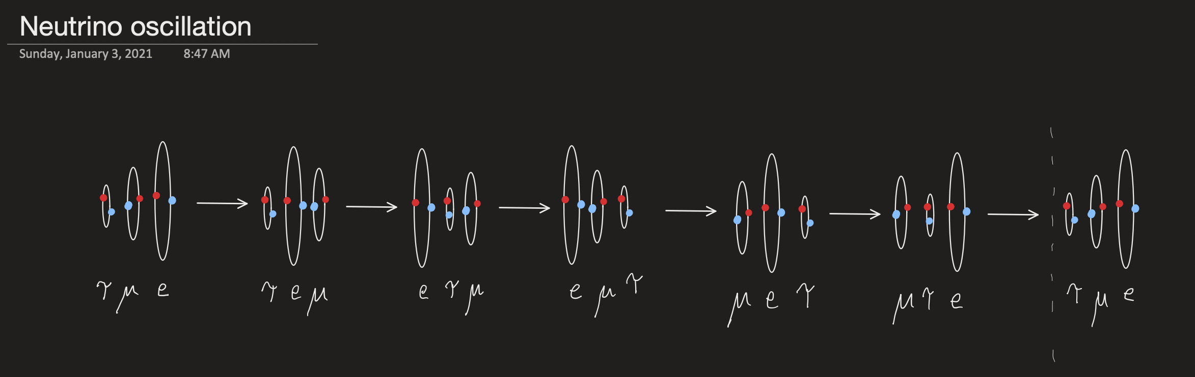
Neutrino Oscillation
Not sure if neutrino musings go here

Slide 25
Emergent Nature
The Four “Forces”

Slide 26
The Four Forces of Nature
PERSONALITY
PERSONALITY
ELECTRO
MAGNETIC
NOETHER CORE
NOETHER CORE
STRONG gluon
GRAVITY is caused by
Emitted potential exciting
Spacetime Noether cores
Which then change shape
WEAK

Slide 27
The Gravitational Force
All particles are continuously and losslessly exchanging energy with neighbors. Frequently, the neighbors are low apparent energy spacetime aether particles, i.e., gravitons.
When standard matter exchanges energy with spacetime we call that the mass of standard matter.
Mass is based on the root mean squared of the interacting potential.
When standard matter provides RMS mass energy to the spacetime aether, it causes the spacetime energy to rise and the constituent Noether cores to deflate.

Slide 28
Unification of the Four Forces
Photons have a 6/6 composition of electrinos and positrinos.
Superfluid is mostly slow photons and neutrinos, around 2.7 Kelvin.
The chart shows gravity beginning near 10⁻³² Kelvin and 10⁻⁴³ seconds.
It seems that the emergence of the spacetime aether is primarily due to redshifting photons and neutrinos.
Credit: Colby College

Slide 29
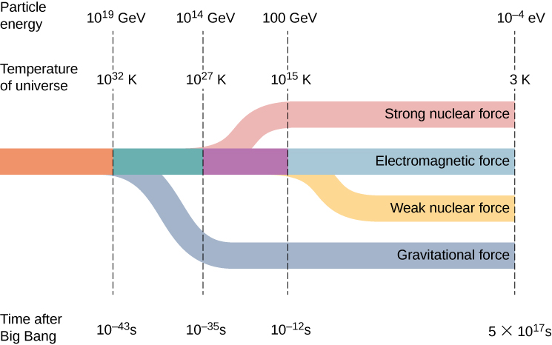
Quantum
Gravity
Quark
Confinement
Neutrino
Transparency
Photon
Transparency
Inflation

Slide 30
Thank You
Questions?

Slide 31
Noether Core Symmetry Breaking Binary and Determinism
Hypothesis: The generation II dipole has velocity @, the symmetry breaking point.
v = @ corresponds to the Planck scale
2 𝜋 r f_{P} = @, r = @ / (2 𝜋 f_{P})
Planck length l_{P} = sqrt (h-bar G/ c³)
Perhaps some of the other Planck constants relate here as well? clues?
The symmetry breaking point is asymmetric
The v > @ AdS “quanta” g is larger than the v < @ CFT “quanta” h.
Does this relate to the frequency relationship of f(I) and f(III)?
In a NC, some kind of interplay occurs between gen I, II, and III where angular momentum does or does not get transferred from an external assembly.
J Mark Morris

